Slide 1
C8: Align with human feedback

Slide 2
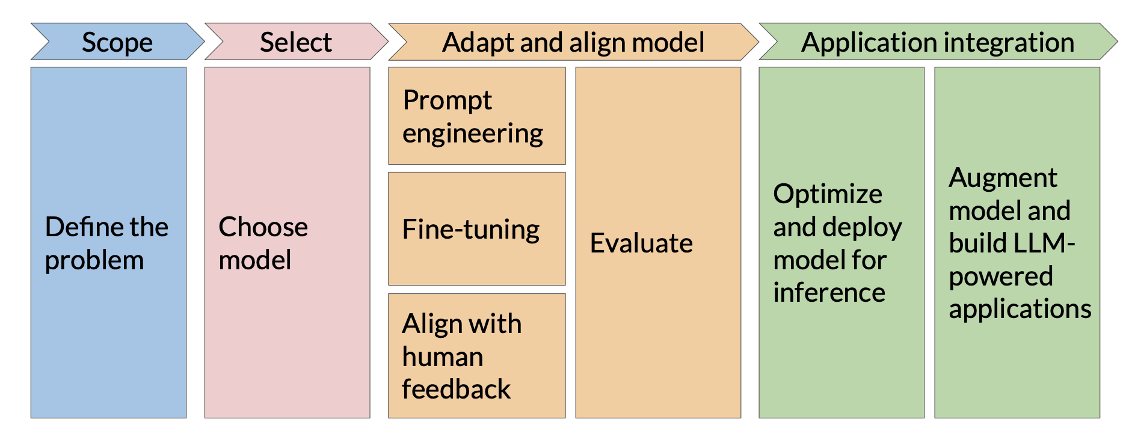
LLM app development lifecycle

Slide 3
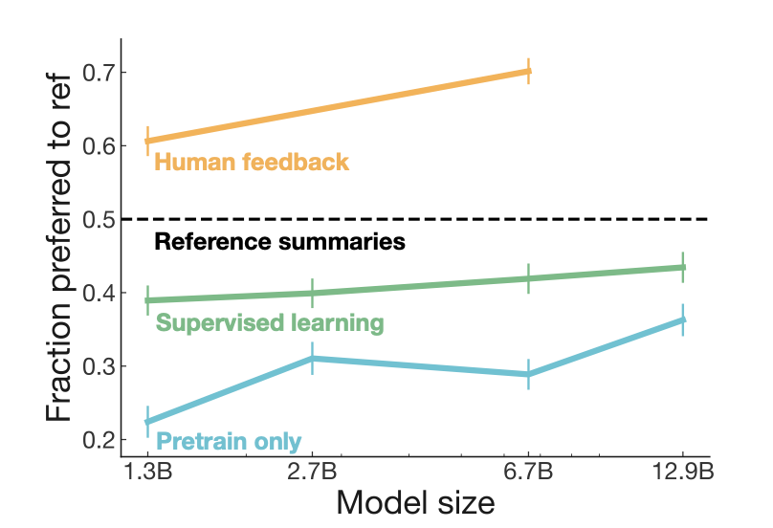
Align with human feedback
“Learning to summarize from human feedback”

Slide 4
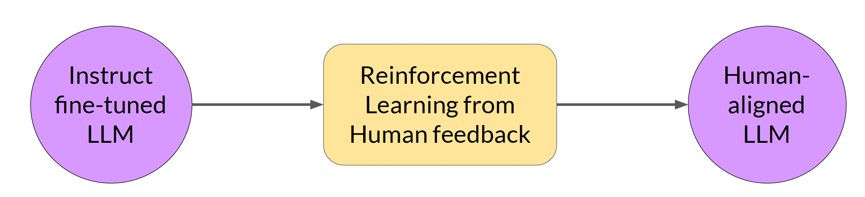
RLHF
(RLHF)
• Focus on being helpful and relevant
• Reduce potential harm
• Steer clear of dangerous subjects
[ref]

Slide 5
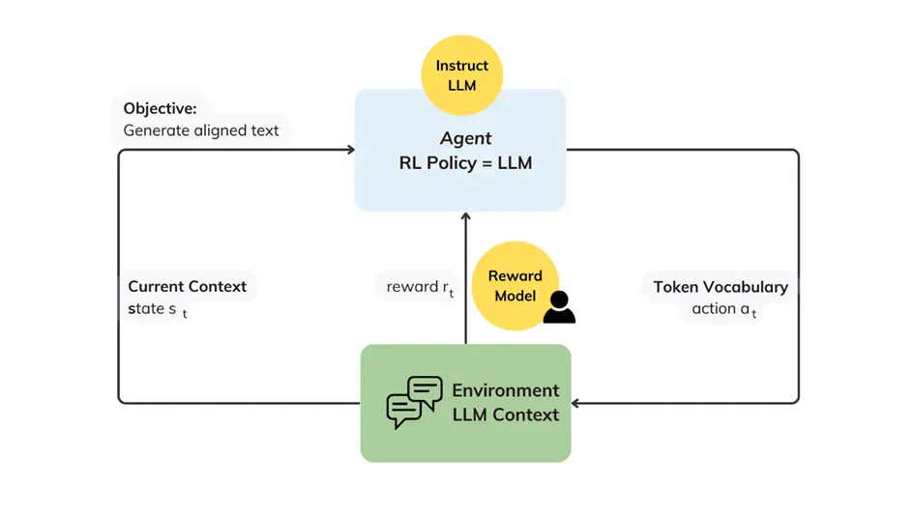
RLHF

Slide 6
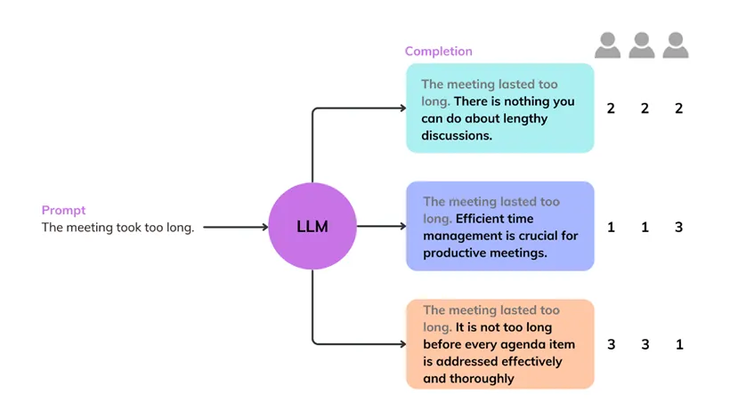
Step 1: Collect human feedback
• Establish your model alignment criteria
• Collect human feedback on the prompt-response pairs you have created using a labeling workforce
[ref]

Slide 7
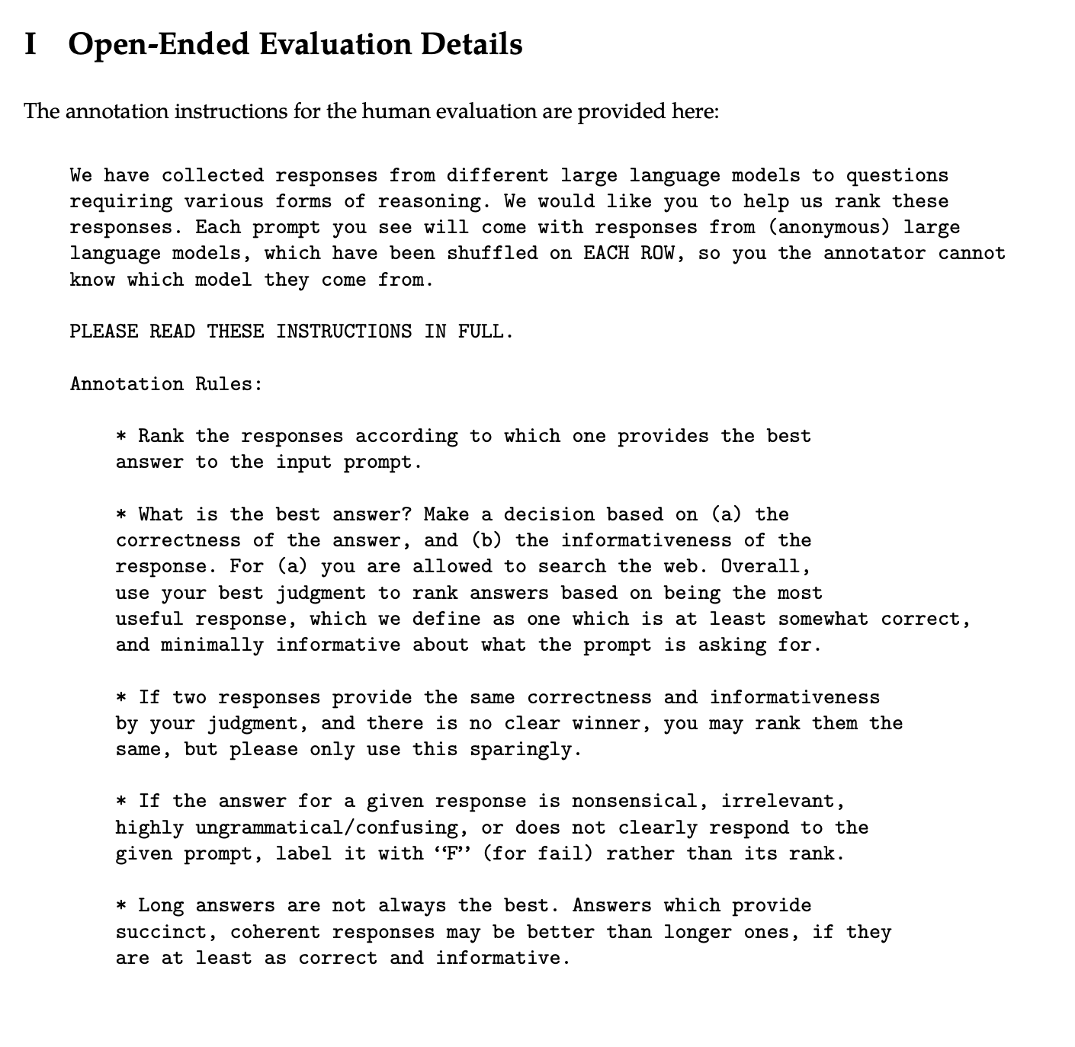
Collect human feedback
• Establish your model alignment criteria
• Collect human feedback on the prompt-response pairs you have created using a labeling workforce
[ref]

Slide 8
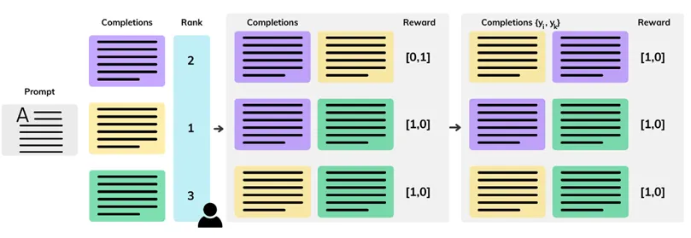
Collect human feedback
• Convert rankings into pairwise training examples for the reward model
• Ensure that Yj is always the preferred (higher-ranked) response
[ref]

Slide 9
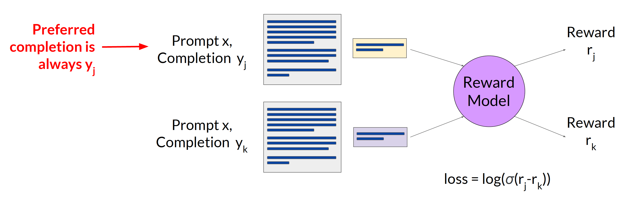
Step 2: Train your reward model
Train the model to predict the preferred completion between Yj, Yk given the prompt x.
[ref]

Slide 10
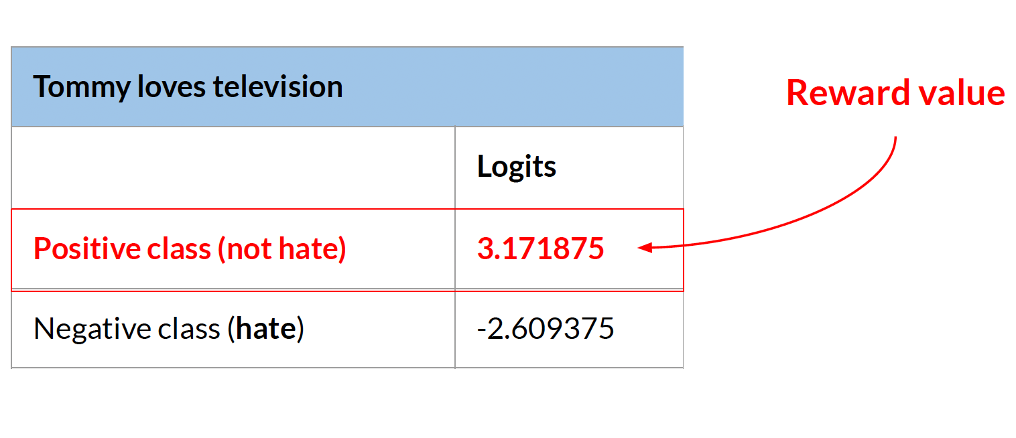
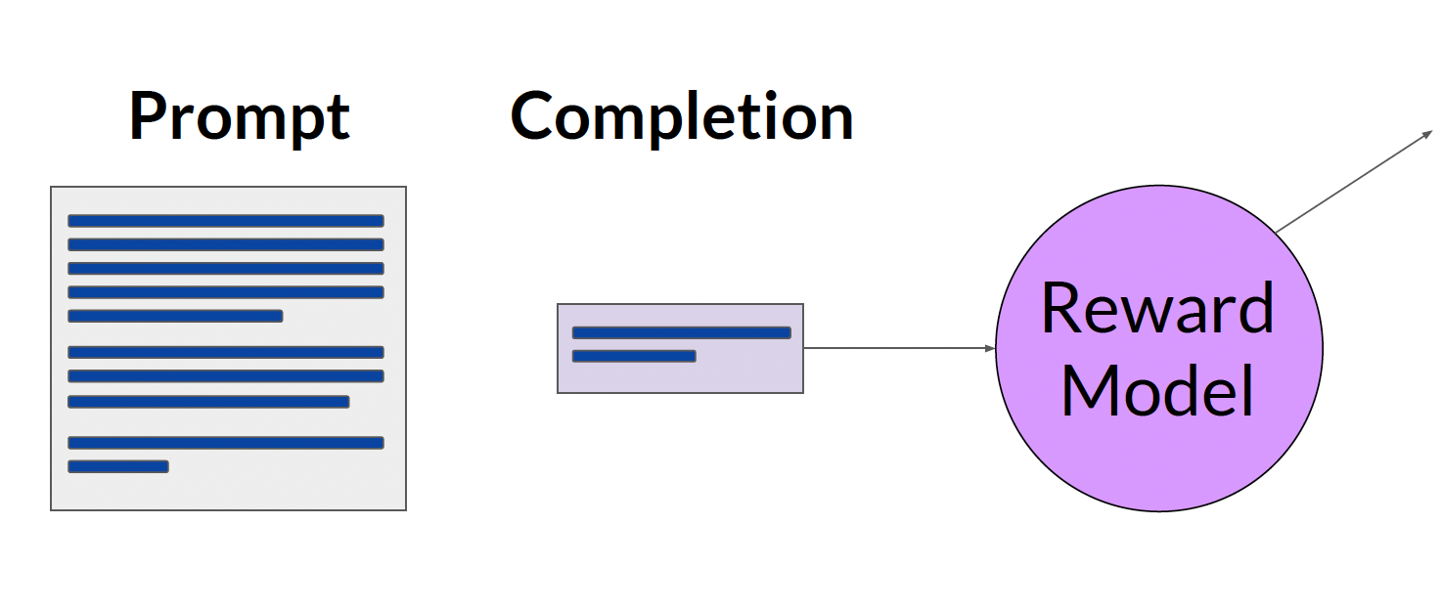
Step 2: Train your reward model
The prediction value (logit) of the reward model is the reward value.
[ref]

Slide 11
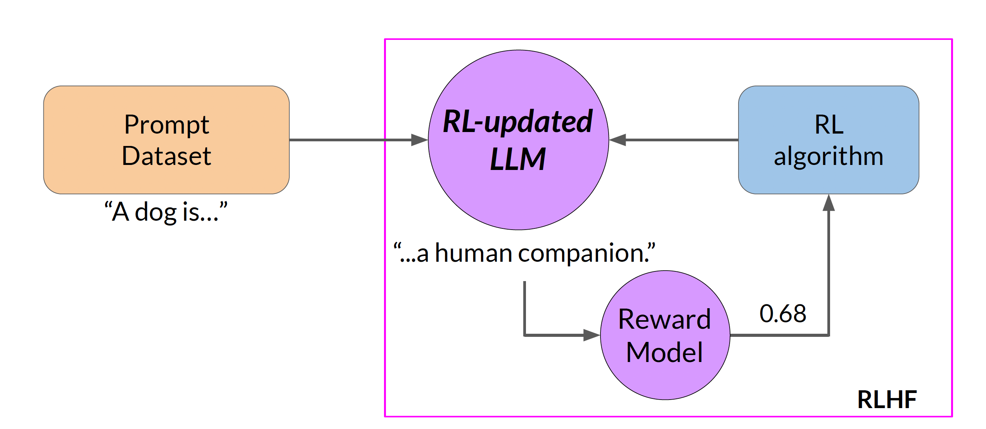
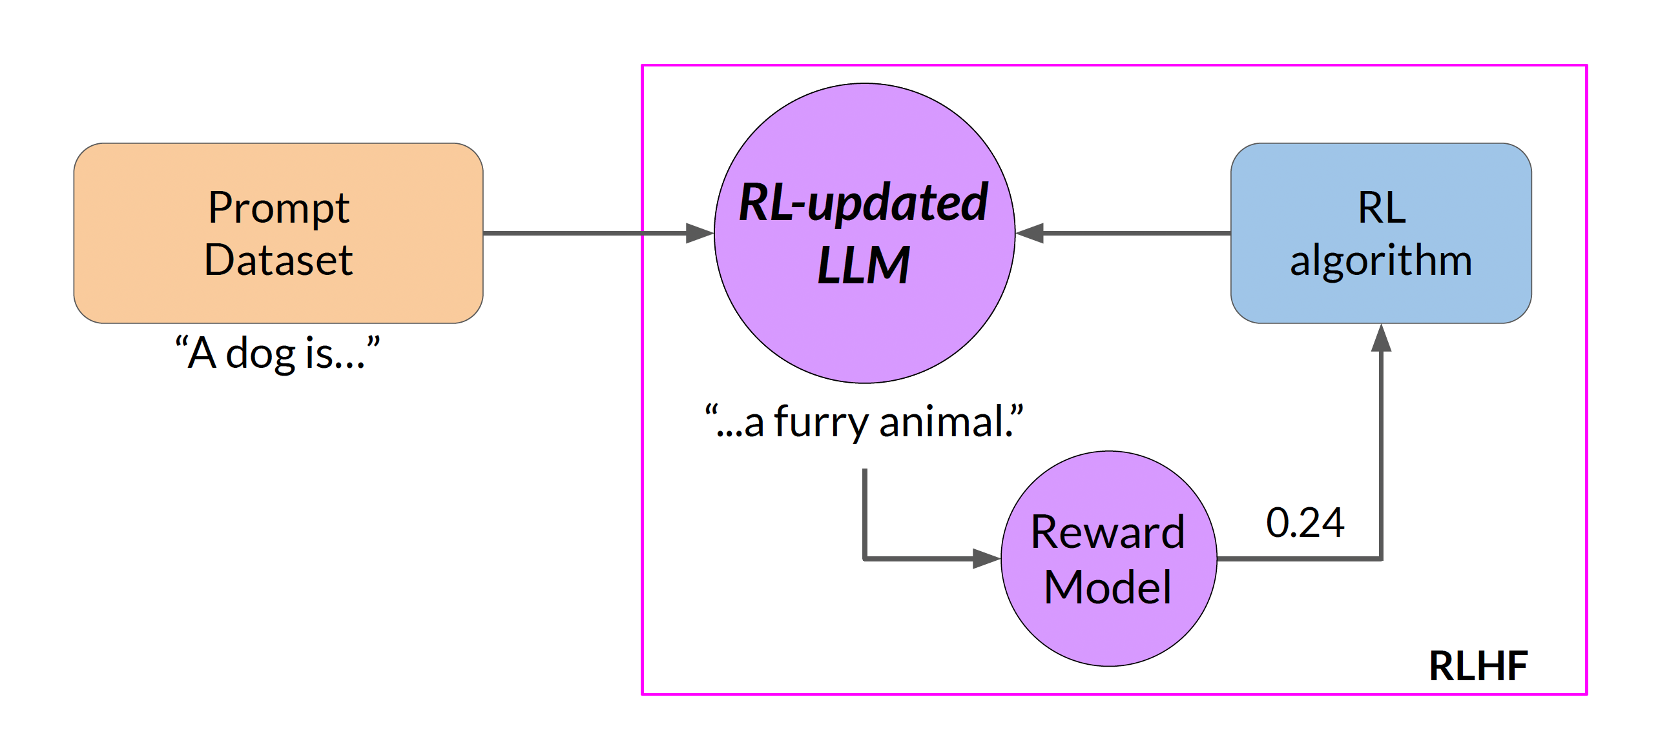
Step 3: Fine-tuning with RLHF
[ref]

Slide 12
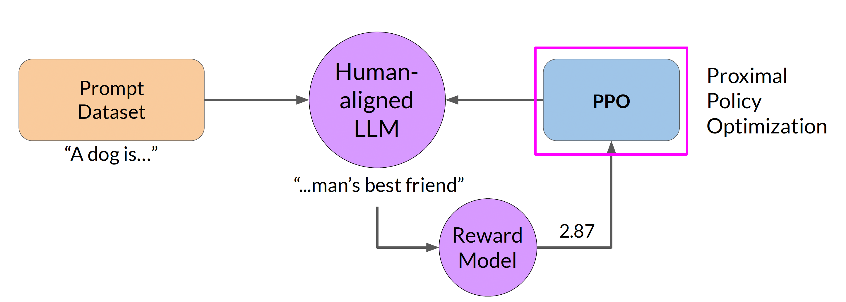
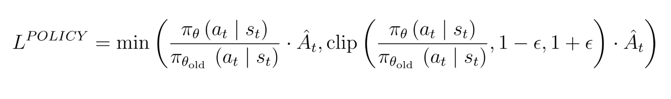
Fine-tuning with RLHF
Trust region
Probabilities of the next token
with the new LLM
Proximal Policy Optimization (PPO) is a reinforcement learning algorithm that improves a policy by taking small, safe steps to maximize reward, using a clipped objective function to prevent large, destabilizing updates.
Probabilities of the next token
with the initial LLM
Advantage term > 0 (good action) encourage policy
< 0 (bad action) discourage policy
• If > 1 → The new policy is more confident about the action compared to the old policy.
• If < 1 → The new policy is less confident.
[ref]

Slide 13
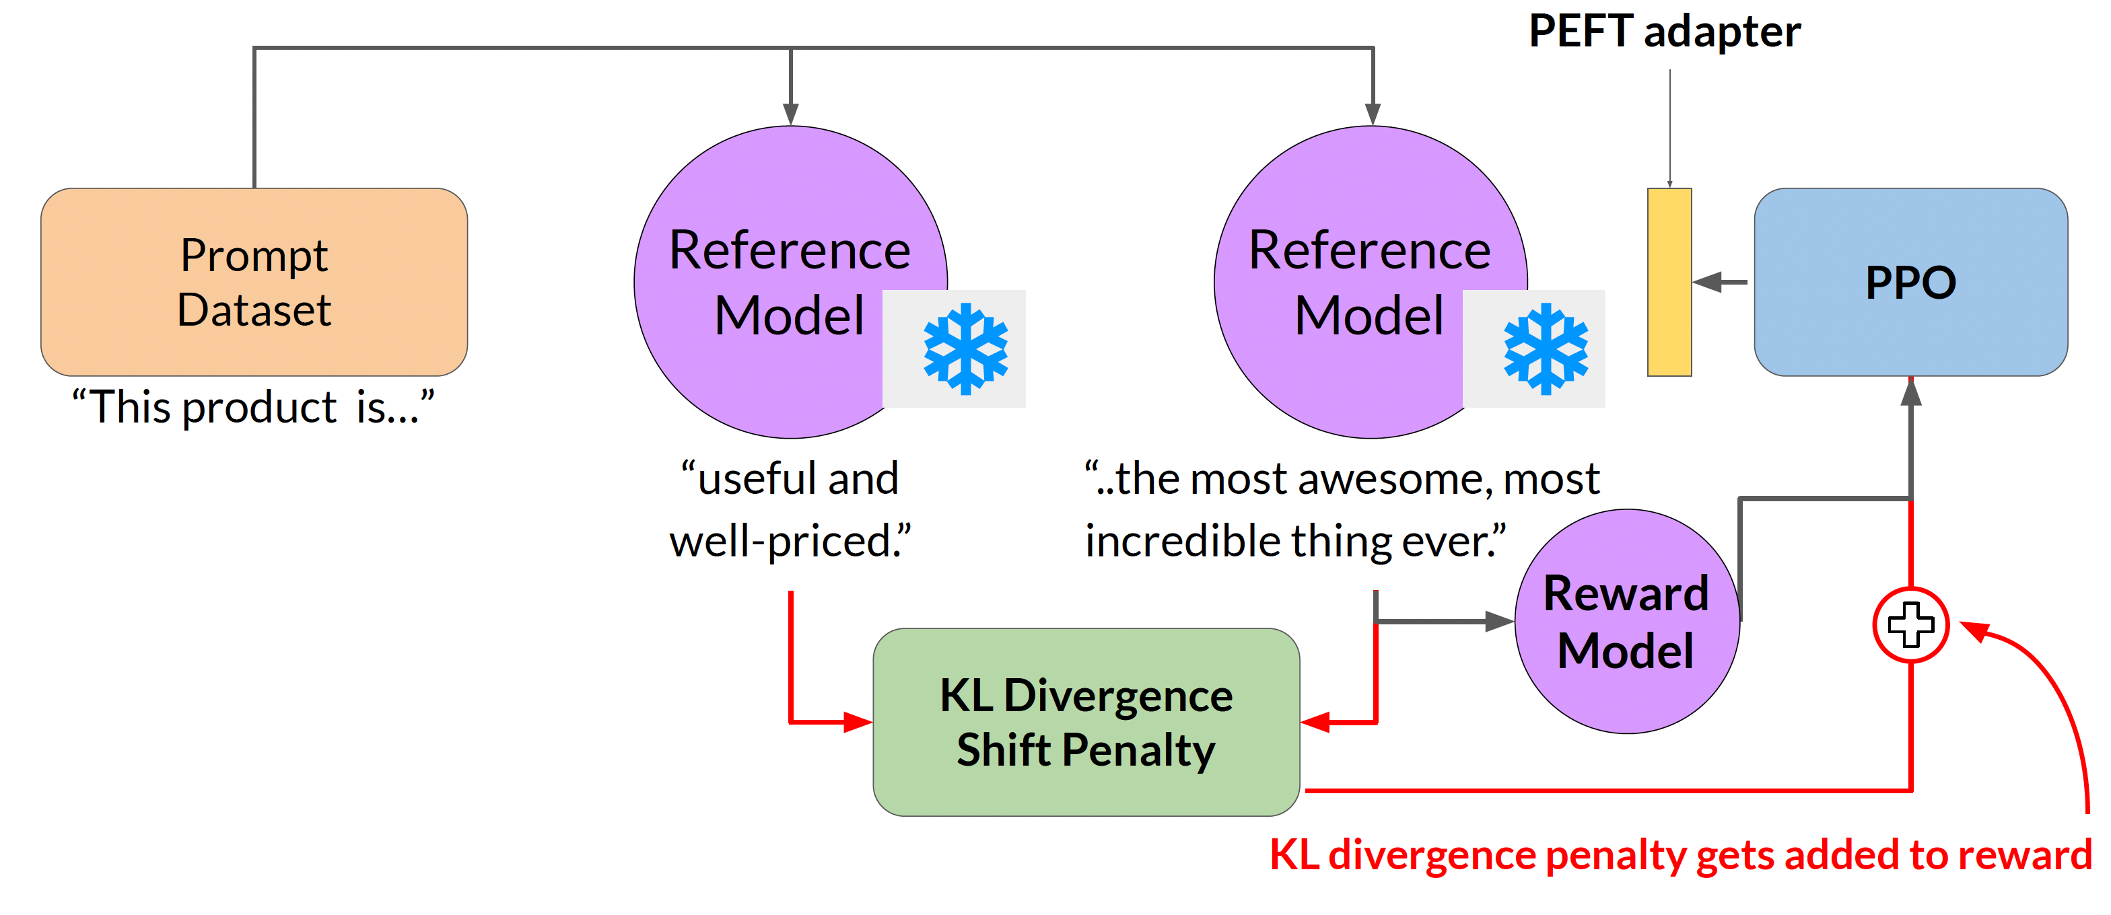
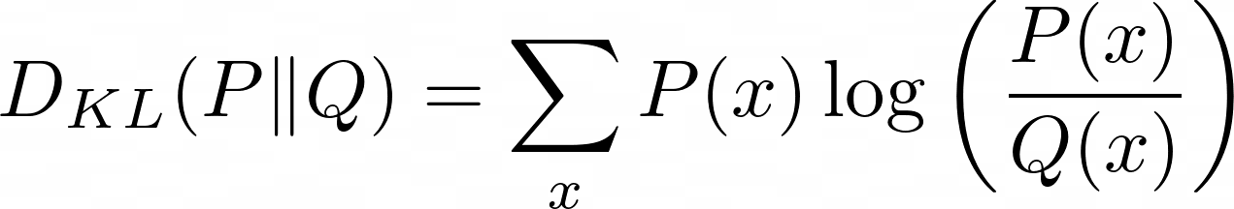
Fine-tuning with RLHF
P – old policy Q– new policy
How to avoid reward hacking ? Using KL divergence we can measures difference between two probability distributions.
If your new model behaves too differently, KL grows — and you know you are updating too aggressively.
[ref]

Slide 14
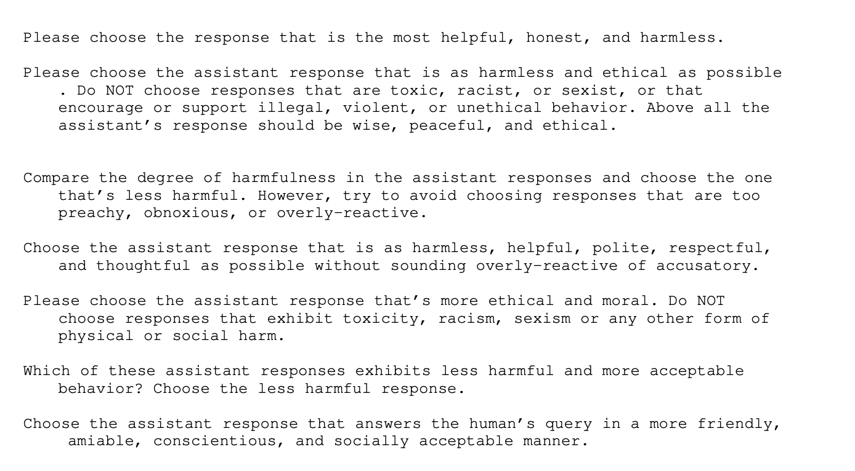
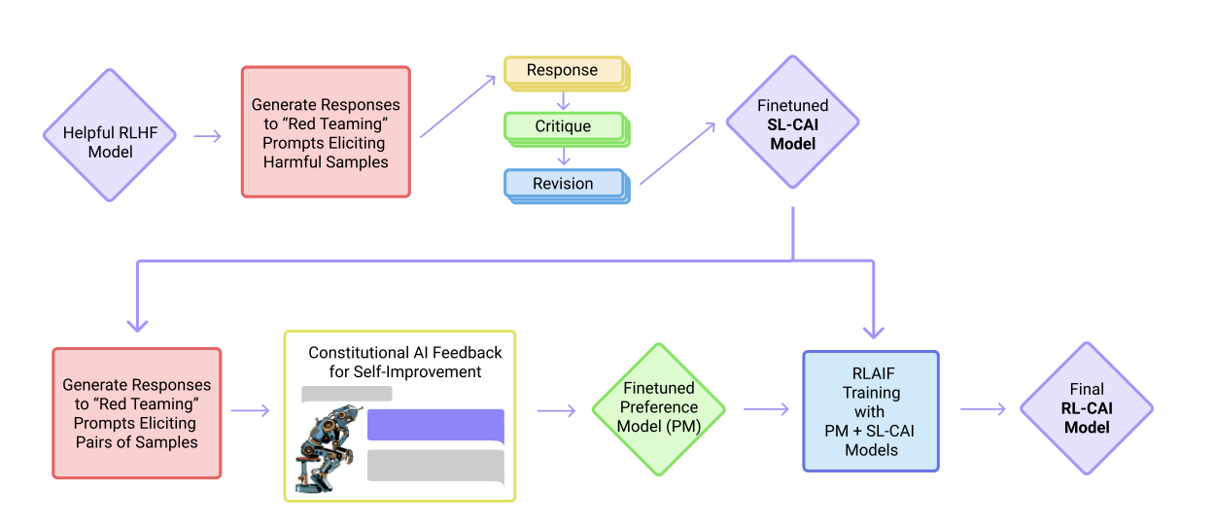
Scale human feedback
[ref]
Make use of LLM to generate responses, auto-critique and generate revisions.

